Slide 1
OneFi: One-Shot Recognition for Unseen Gesture via COTS WiFi
Rui Xiao, Jianwei Liu, Jinsong Han, Kui Ren
SenSys 2021

Slide 2
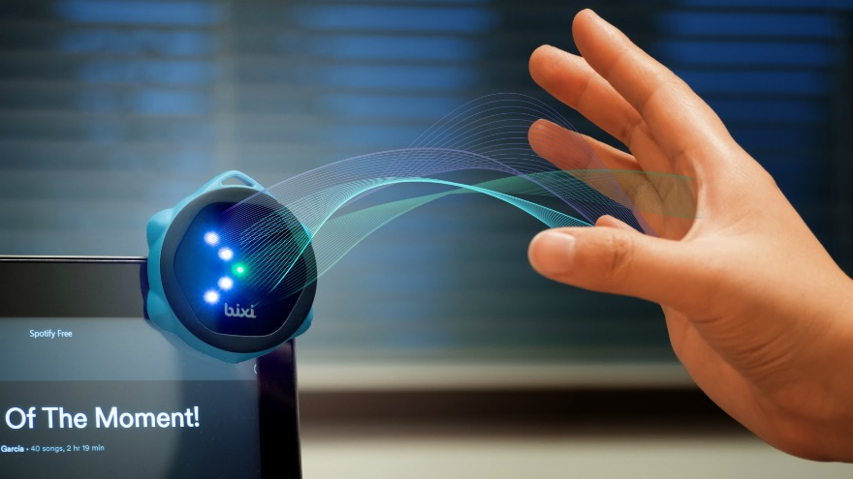
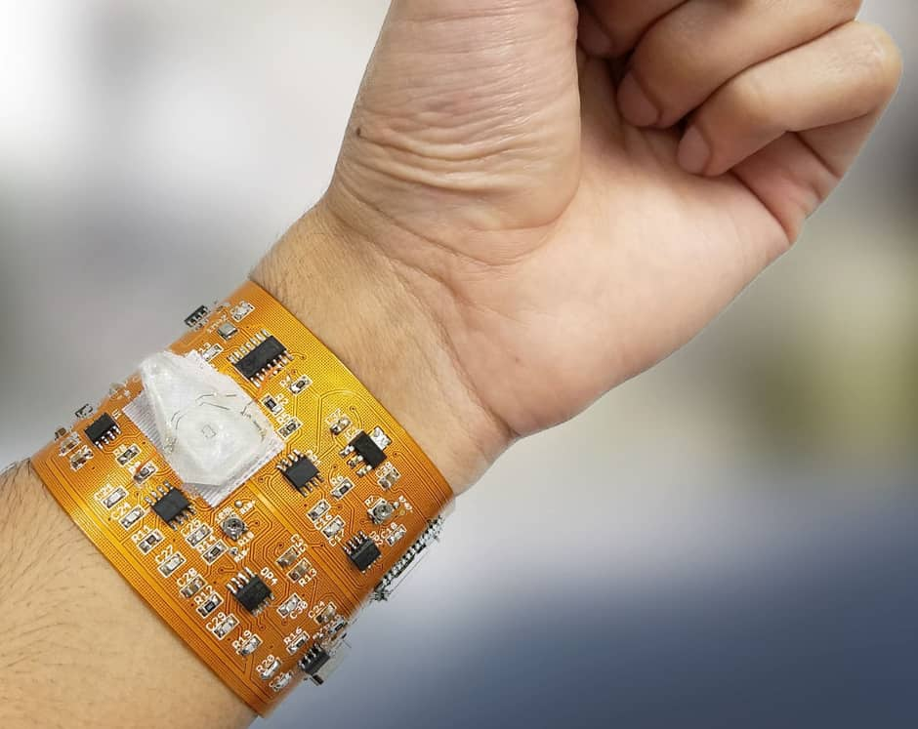
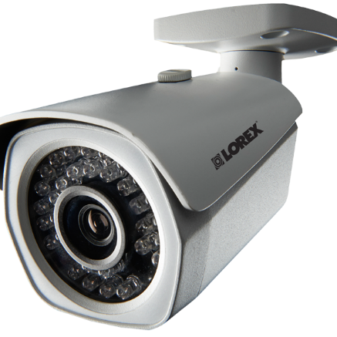
Human Gesture Recognition (HGR)
Virtual Reality
Medical Control
Smart Home Automation
WiFi-based solution:
No need to wear sensors
Less intrusive to user privacy
And also ubiquitous
Uncomfortable
Privacy Leakage

Slide 3
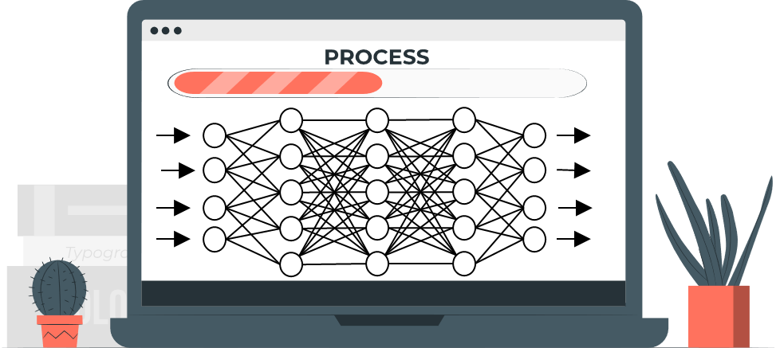
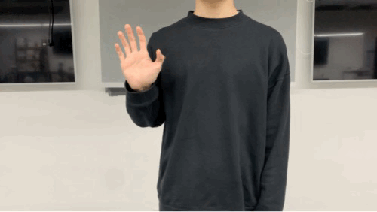
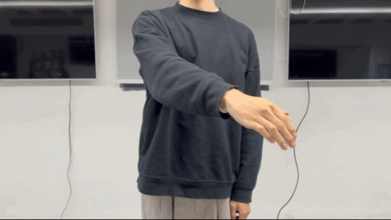
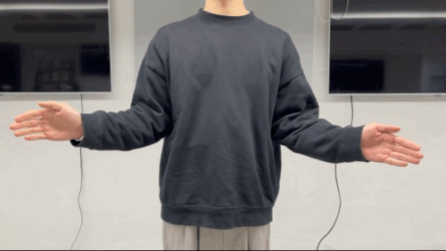
WiFi-based HGR
Works under supervised learning scheme: Three phases
Predefine base gestures
Training data collection
Model training
Question: What if now we want to recognize unseen gestures which are not included in base gestures?
Base gestures:
Push Forward
Draw Zig-Zag
Clap

Slide 4
Unseen gestures are important.
Limited Scalability
Predefined base gestures cannot keep up with ever-evolving demands.
It’s crucial to allow the user to adapt the system to their own preference.
However, in existing systems, to recognize unseen gestures …
Collect unseen gesture samples
Data Collection Overhead
Retrain the whole model
Training Overhead
Please perform ‘wave’ for 20 times.

Slide 5
Problem Definition
Assume that our system can recognize a few base gestures.
When introducing unseen gestures, is it possible that:
User only needs to collect one signal sample for any unseen gestures.
Model can fast adapt to new data without retraining the whole model.
This problem falls into the category of few shot learning.
-- Learning with a few samples.

Slide 6
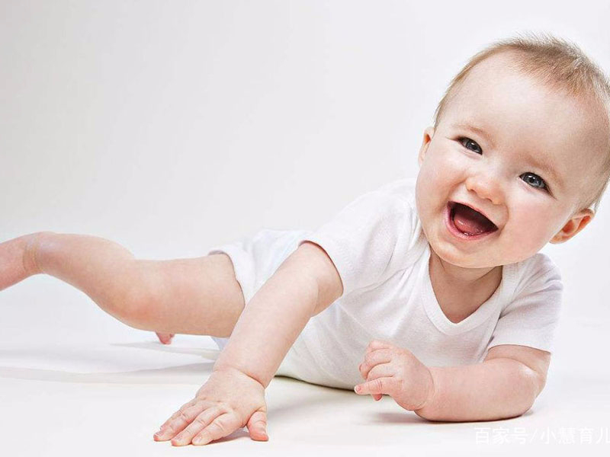
Few shot learning
One shot is enough.
Few shot learning is easy for human.
Why?
Because human beings have a large amount of prior knowledge.

Slide 7
Few shot learning: Basics
In few shot learning context
Training set is also called support set
Testing set is also called query set
Model
Support Set
(Few shot samples)
Model
Query Set
prior knowledge
No overlap with support set
Base Dataset
Recognition Result
Training Phase
Testing Phase

Slide 8
Existing works: Meta-learning as few shot solution
A simple view of meta-learning: learning to learn
Task 1: ${f_{θ}}_{1}$
Normal Learning
Task 2: ${f_{θ}}_{2}$
Train a “learner” model: $f_{θ}$
Meta Learning
Train a “Meta-learner”: $g_{φ}$
I’ll teach $f_{θ}$ how to learn faster

Slide 9
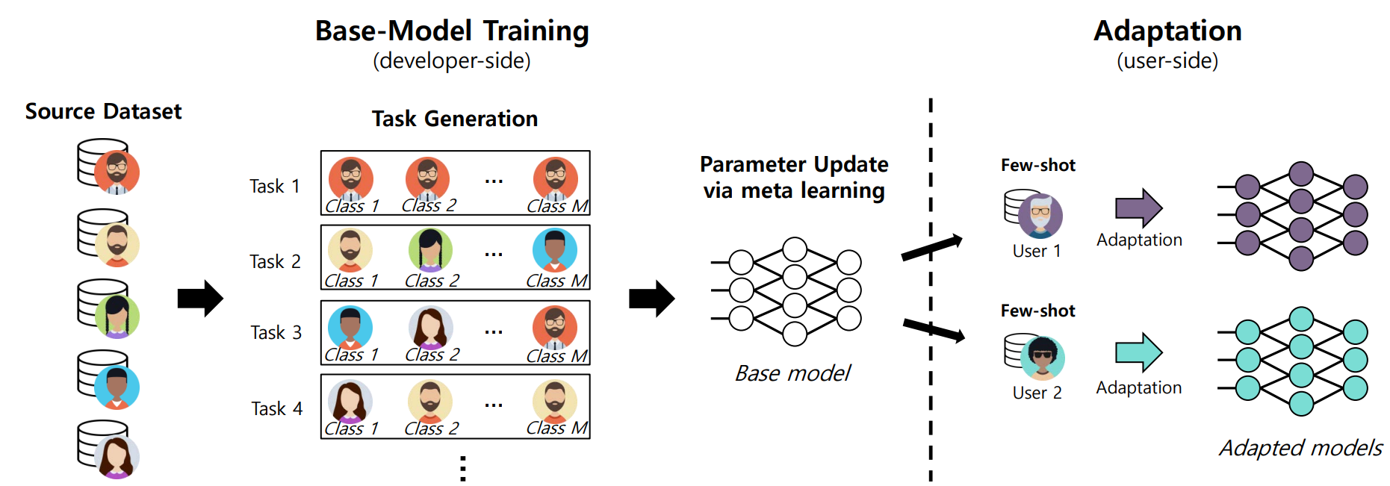
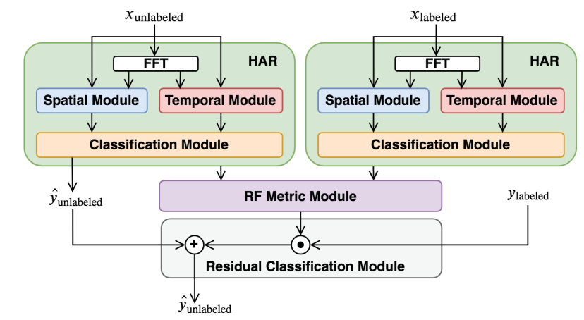
Existing works: Meta-learning as few shot solution
MetaSense (Gong et al, SenSys’19)
New user and new device.
RF-Net (Ding et al, SenSys’20)
New environments.
MetaSense
RF-Net

Slide 10
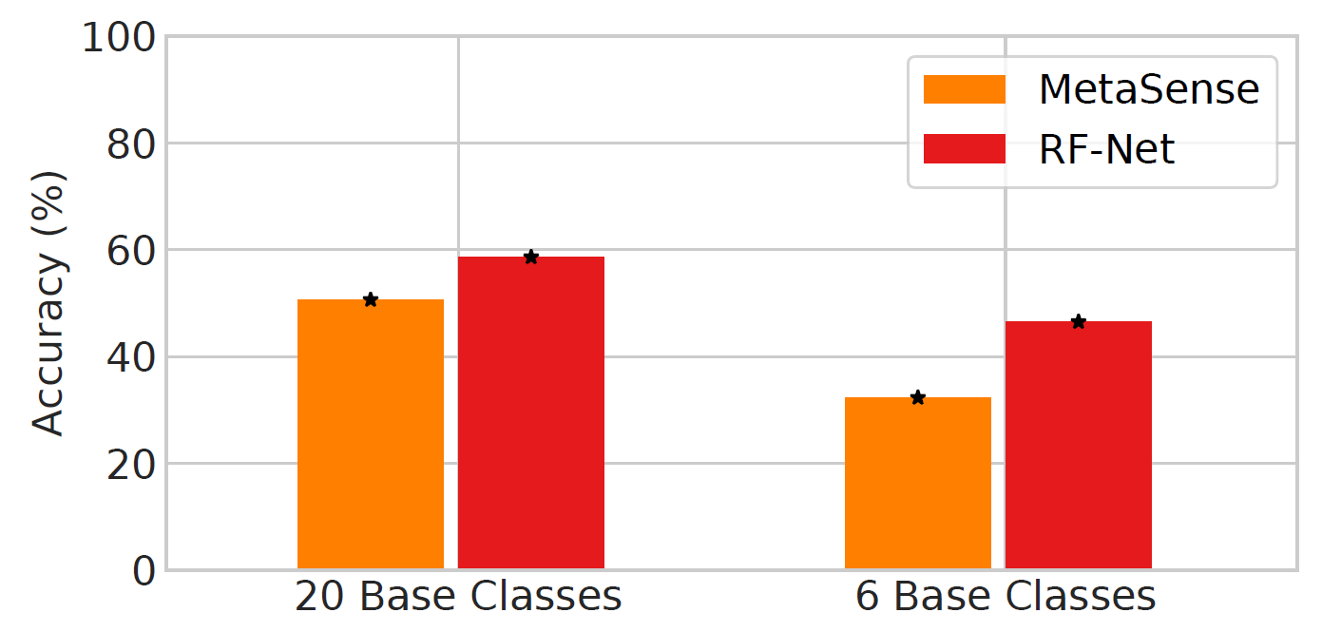
Challenge 1: Insufficient Prior Knowledge
The base dataset in WiFi HGR system is usually small.
Therefore, the prior knowledge is usually insufficient.
We use 20 gestures as base classes and apply meta-learning scheme, the result of one shot recognition for unseen gestures is unacceptable:

Slide 11
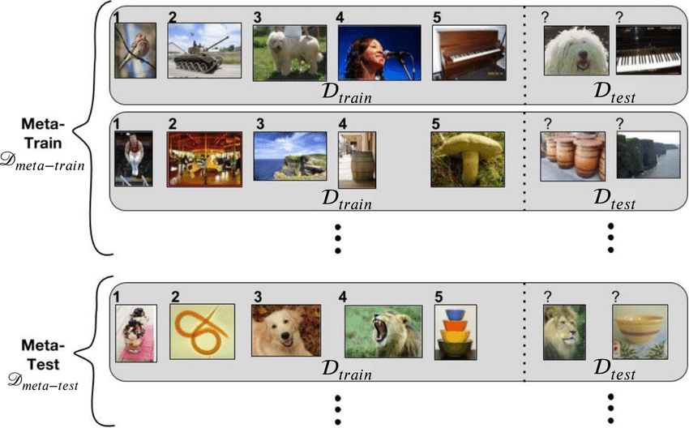
Challenge 2: Complicated Training Process
Meta-learning multiplies the complexity of the regular training process.
Task 1: ${f_{θ}}_{1}$
Unseen Gesture Training
Training Overhead
Task 2: ${f_{θ}}_{2}$
Extract Prior Knowledge from Base Classes

Slide 12
Our Solution -- OneFi
Overview:
A data augmentation method based on signal modeling
Enrich the prior knowledge
(Solve Challenge 1)
Base Dataset
Pre-processing
Data Augmentation
Extract Prior Knowledge
Support Set
Pre-processing
One-Shot Adaption

Slide 13
Our Solution -- OneFi
Overview:
A data augmentation method based on signal modeling
Enrich the prior knowledge
(Solve Challenge 1)
A similarity-based one-shot learning framework
Alleviate Training Overhead
A self-attention-based backbone
(Solve Challenge 2)
Base Dataset
Pre-processing
Data Augmentation
Extract Prior Knowledge
Support Set
Pre-processing
One-Shot Adaption

Slide 14
Our Solution -- OneFi
Overview:
A data augmentation method based on signal modeling
Enrich the prior knowledge
A similarity-based one-shot learning framework
Alleviate Training Overhead
A self-attention-based backbone
Base Dataset
Pre-processing
Data Augmentation
Extract Prior Knowledge
Support Set
Pre-processing
One-Shot Adaption

Slide 15
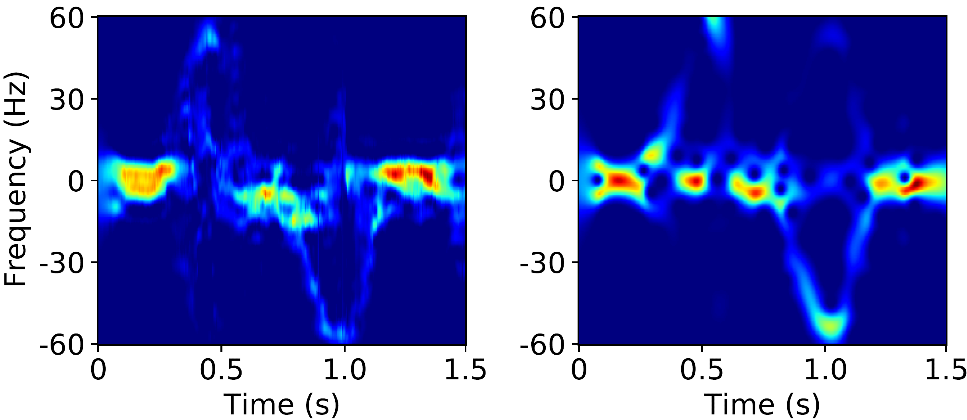
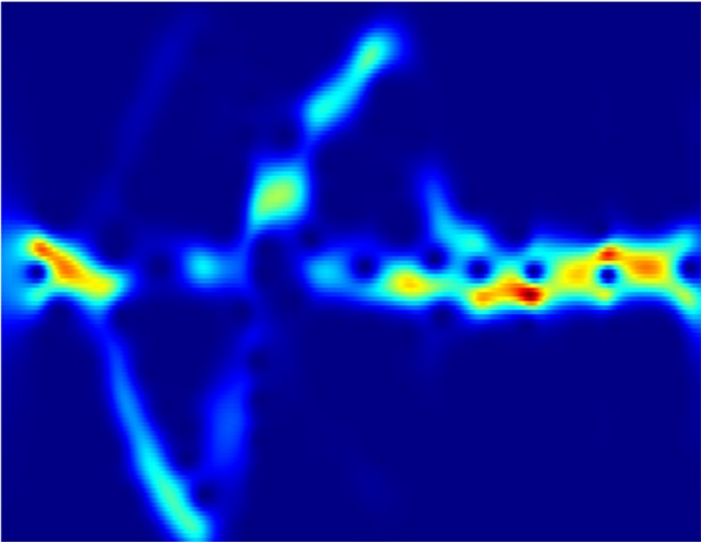
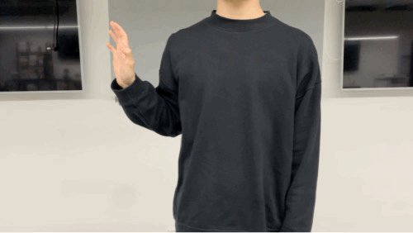
Data Augmentation – Generate Virtual Gestures
Generates additional, synthetic data by signal modeling
The intuition here is that we could generate a ‘push left’ gesture by rotating a ‘push forward’ gesture.
Doppler Spectrogram
Push Forward
Push Left

Slide 16
Data Augmentation – Generate Virtual Gestures
Question: How to rotate a gesture?
Signal modeling is required!
We compute the velocity distribution of the gesture, and apply rotation on the velocity domain.

Slide 17
Data Augmentation – Generate Virtual Gestures
We compute the velocity distribution of the gesture, and apply rotation on the velocity domain.
Virtual gesture is nearly identical to real gesture.
Creating virtual gesture can enrich the prior knowledge.
virtual gesture
real gesture

Slide 18
Our Solution -- OneFi
Overview:
A data augmentation method based on signal modeling
A similarity-based one-shot learning framework
Alleviate Training Overhead
A self-attention-based backbone
Base Dataset
Pre-processing
Data Augmentation
Extract Prior Knowledge
Support Set
Pre-processing
One-Shot Adaption

Slide 19
Similarity-based one-shot learning framework
Feature
Extractor
Stage 1
Train
Classifier C1
Base Classes
Encode Prior knowledge into the feature extractor
Finetune a new classifier C2 based on the support set
Loss
…
…
…
Fix Weight
Support Set
Feature
Extractor
Stage 2
Fine-tune
Unseen Classes
Cosine Distance
Classifier C2
Query Feature
Query Set
Cosine Distance
$$=($$
$$D_{1}$$
$$D_{2}$$
$$D_{3}$$
$$D_{4}$$
$$D_{5}$$
$$D_{6}$$
$$)$$
Lightweight one-shot learning framework
Alleviating the training overhead

Slide 20
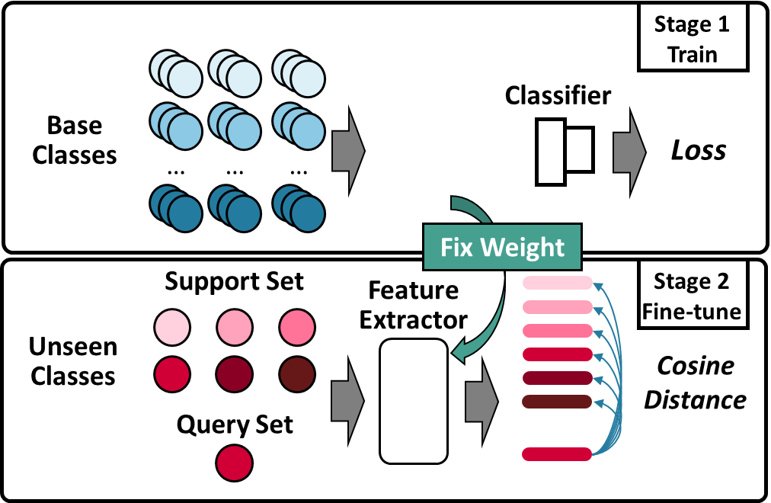
Our Solution -- OneFi
Overview:
A data augmentation method based on signal modeling
A similarity-based one-shot learning framework
A self-attention-based backbone
Alleviate Training Overhead
Feature
Extractor

Slide 21
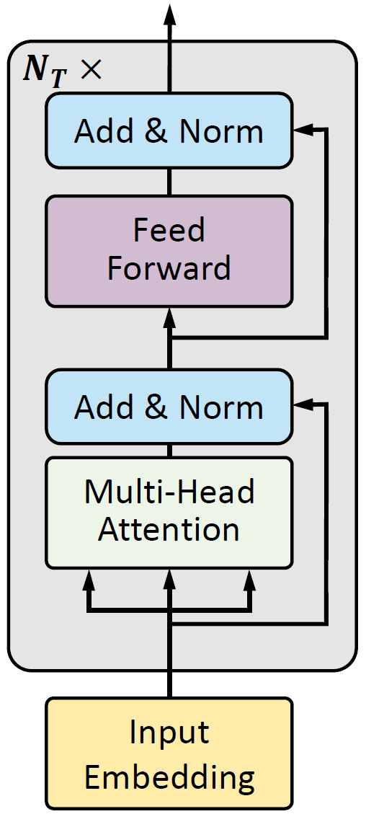
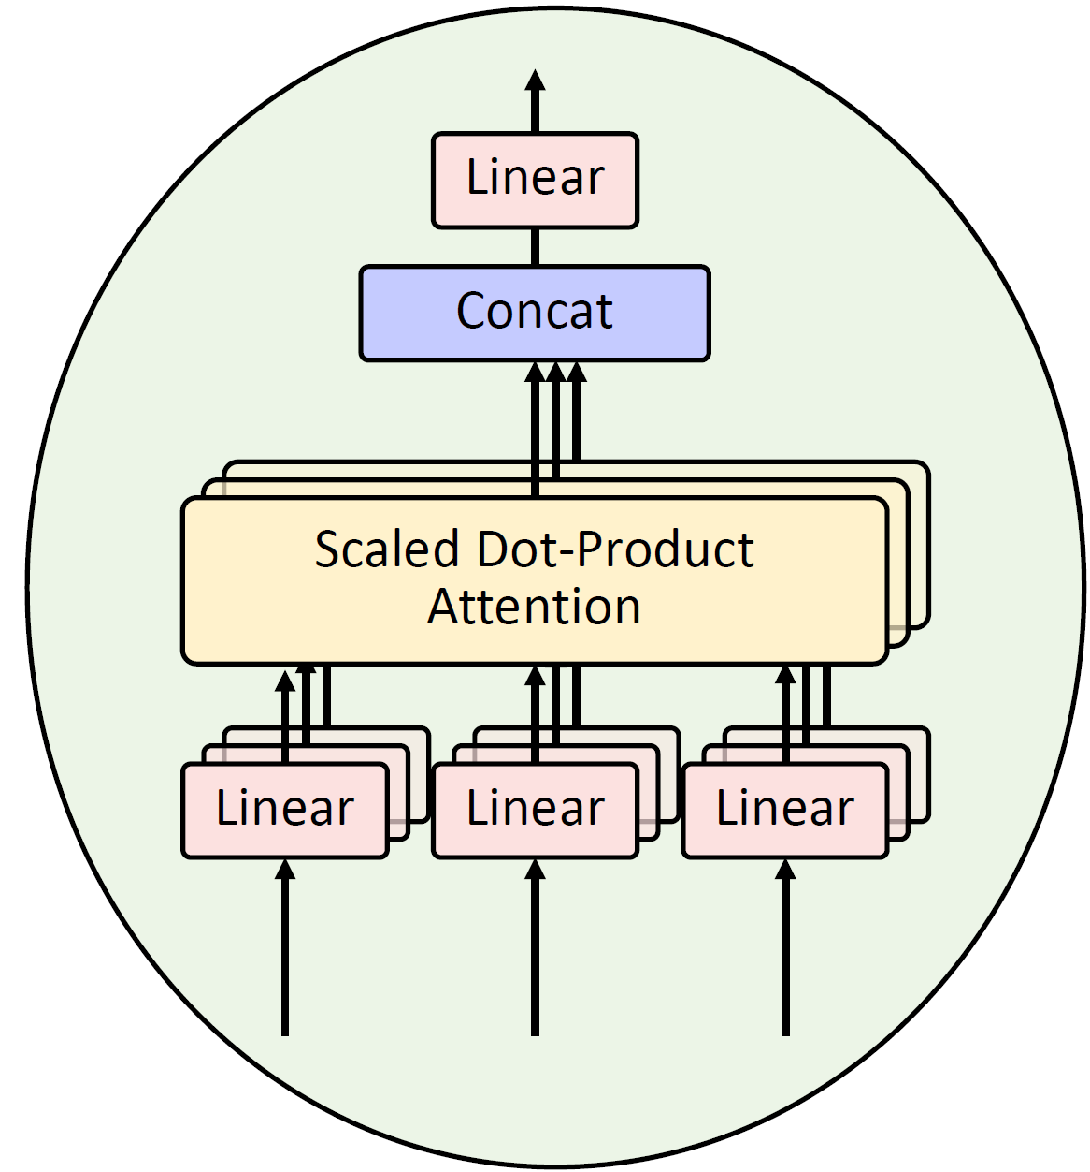
WiFi Transformer: A backbone
self-attention-based
Transformer Encoder
Multi-Head Attention
Output
Transformer Encoder
Position
Embedding
0
CLS
1
2
3
4
5
6
7
8
9
Linear Projection of Time Patches
Only needs O(1) sequential operations
Reduces the overhead of training the feature extractor

Slide 22
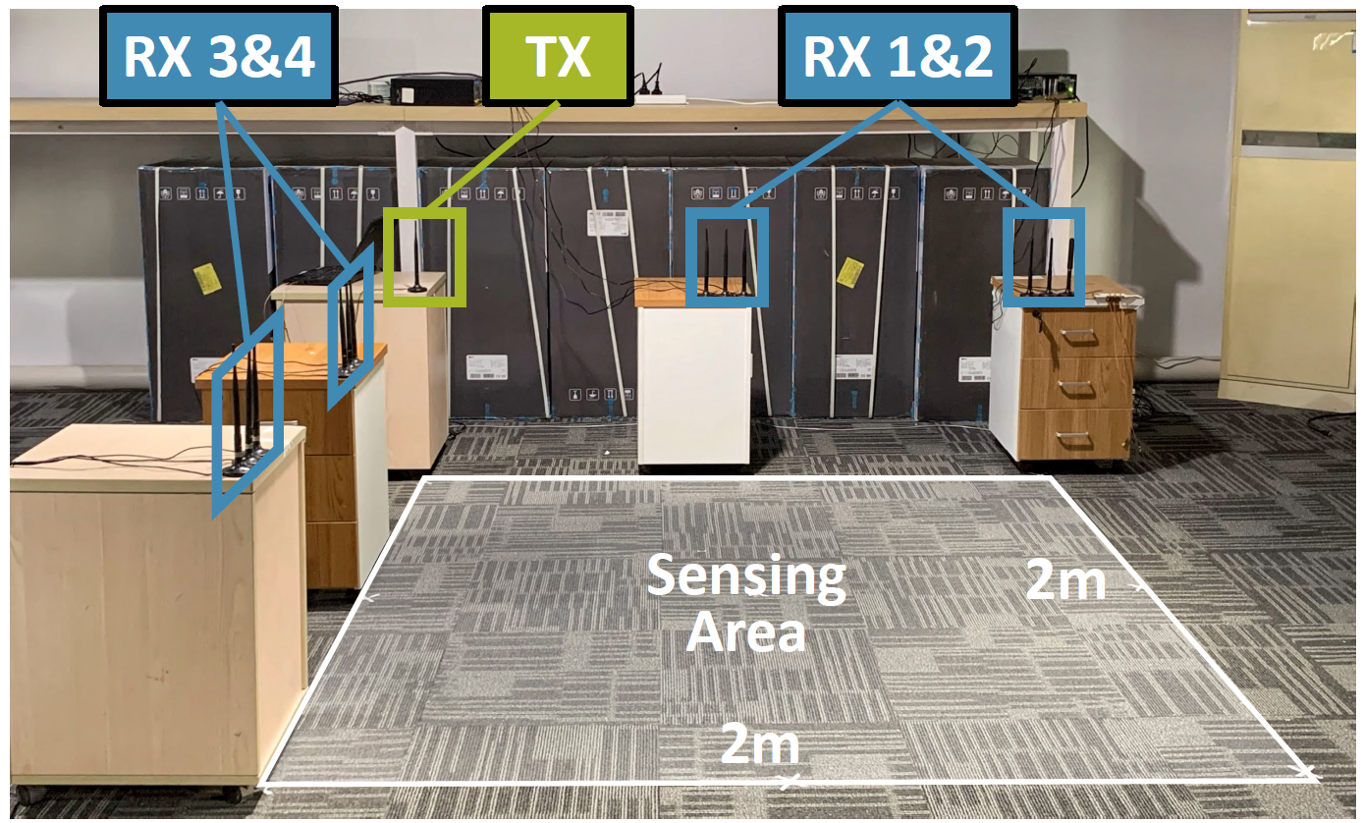
Evaluation Setup
Implementation
Desktops with Intel 5300 NIC
Collect 40 difference gesture classes.
20 as base dataset
E.g. Draw ‘1’, Draw ‘2’, Draw ‘U’, Draw Circle, Draw Rectangle …
20 as unseen dataset
E.g. Draw ‘a’, Draw ‘b’, Slide, Sweep, Draw Zig-zag …

Slide 23
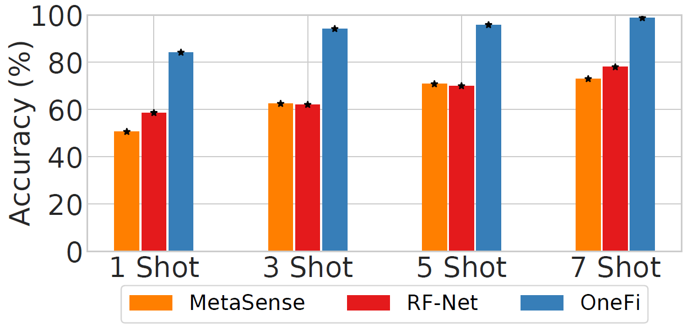
Overall Accuracy
Upon six-unseen-gesture classification
Outperform MetaSense and RF-Net greatly

Slide 24
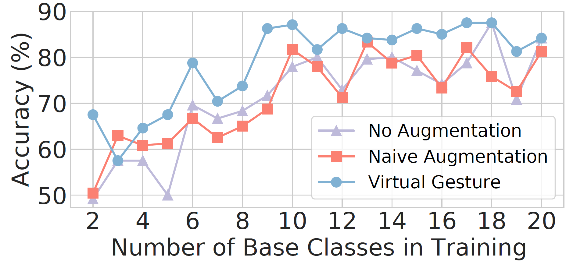
Effect of Virtual Gestures
Virtual gesture generation is effective in enriching the prior knowledge and improving few-shot recognition accuracy.

Slide 25
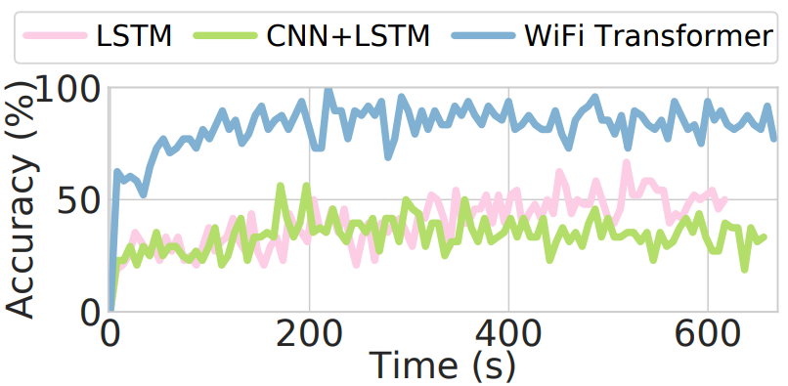
Training Overhead
Different learning frameworks
Different backbone networks
Converge in 2 mins
OneFi entails significantly less training overhead.
WiFi Transformer help to relieve the training overhead.

Slide 26
Summary of other evaluation results
By adding more shots, OneFi can achieve high accuracy in 20-unseen-gesture classification.
OneFi works well with small number of WiFi receivers.
OneFi generalizes in cross-domain experiments.
(72% with 3 shots)
(1 or 2 receivers)

Slide 27
Conclusion
We design OneFi, a one-shot WiFi HGR system. Extensive experiments demonstrate its strong ability to recognize unseen gestures.
We present a novel virtual gesture generation technique that significantly enriches the prior knowledge.
We propose a lightweight one-shot learning framework, together with a self-attention based backbone to alleviate training overhead.
Thanks! & Questions?

